Slide 1

Signals and Systems Credit Hours = 3 by Dr. Wazir Muhammad Laghari Email: wazirlaghari@buetk.edu.pk
Electrical Engineering Department
Balochistan University of Engineering and Technology
Khuzdar

Slide 2
Shifting of Continuous-Time Signals
Shifting means shift the signal position to left or right is called Shifting.
Shifting is the two types:
Time Shifting
Amplitude Shifting

Slide 3
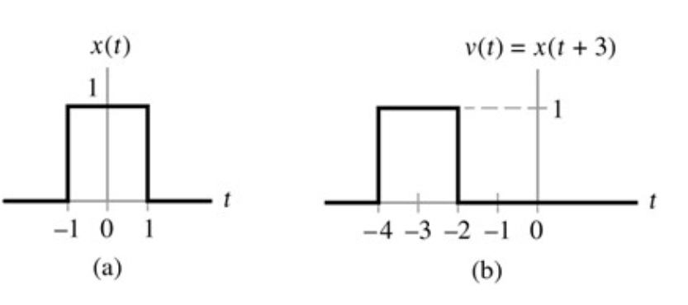
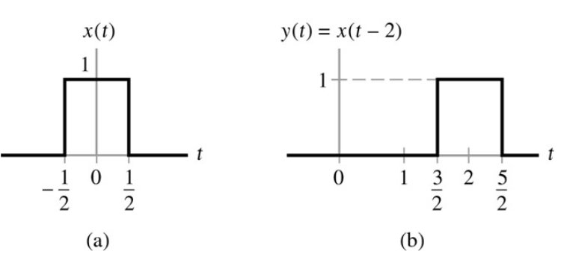
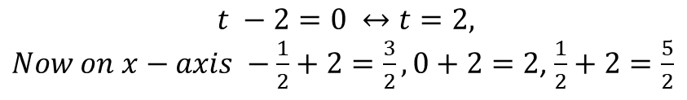
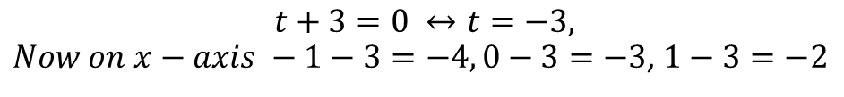
Time Shifting of Continuous-Time Signals
Left Shifting OR
Time Advance
Right Shifting OR
Time Delay
$$t −2=0 ↔t=2,$$
$Now on x−axis −\frac{1}{2}+2=\frac{3}{2}, 0+2=2$, $\frac{1}{2}+2=\frac{5}{2}$
$$t+3=0 ↔t=−3,$$
$Now on x−axis −1−3=−4, 0−3=−3$, $1−3=−2$

Slide 4
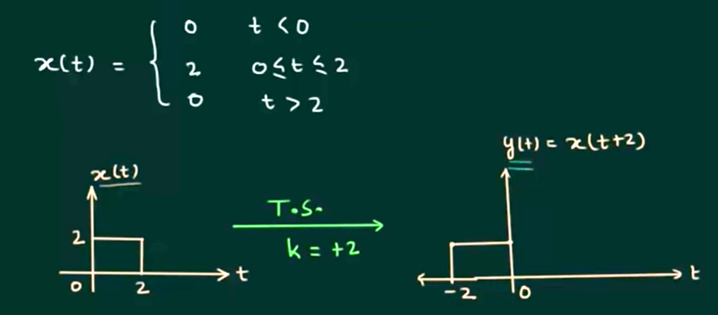
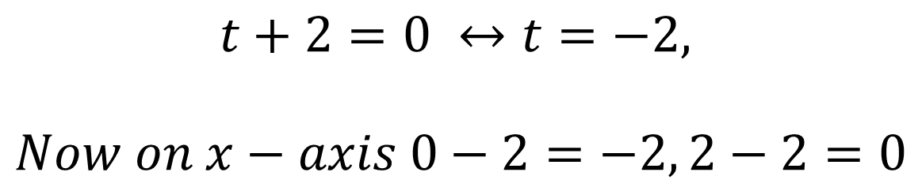
Time Shifting of Continuous-Time Signals
$$t+2=0 ↔t=−2,$$
$$Now on x−axis 0−2=−2, 2−2=0$$

Slide 5
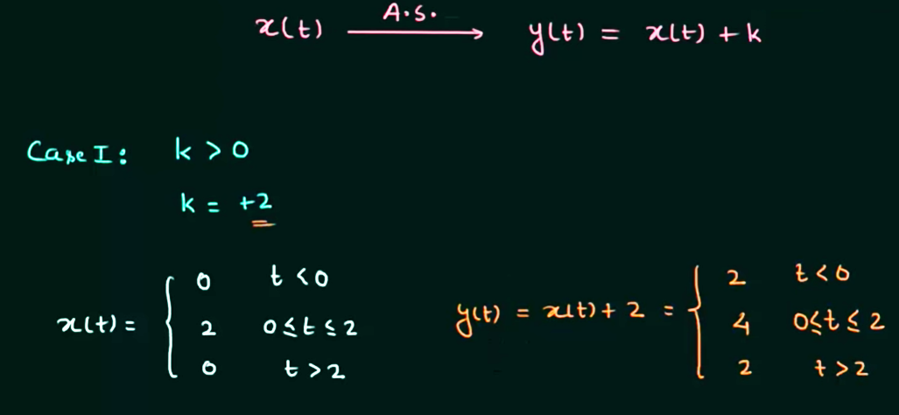
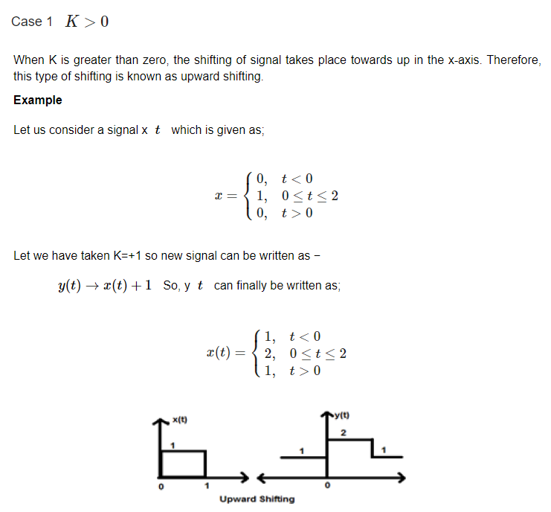
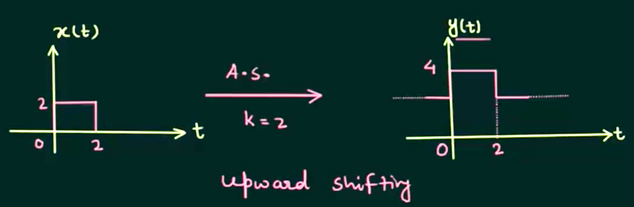
Amplitude Shifting of Continuous-Time Signals

Slide 6
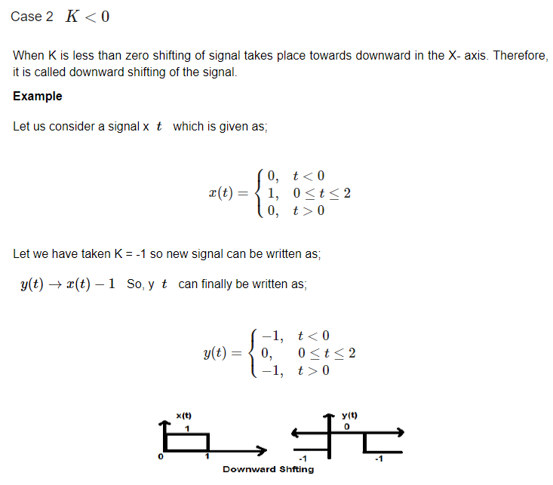

Slide 7
Reversal/Reflection/Folding of Continuous-Time Signals
Whenever the time in a signal gets multiplied by -1, the signal gets reversed.
It produces its mirror image about Y or X-axis. This is known as Reversal of the signal.
Reversal can be classified into two types based on the condition whether the time or the amplitude of the signal is multiplied by -1

Slide 8
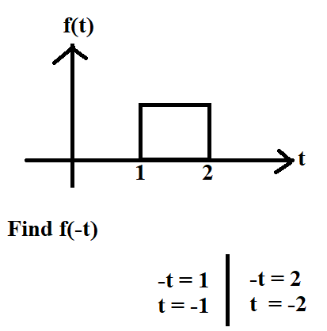
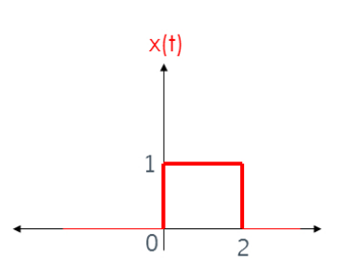
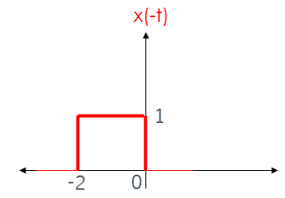
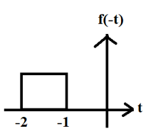
Reversal of Continuous-Time Signals Case-1: Time Reversal/Folding/Reflection
Folded on x-axis

Slide 9
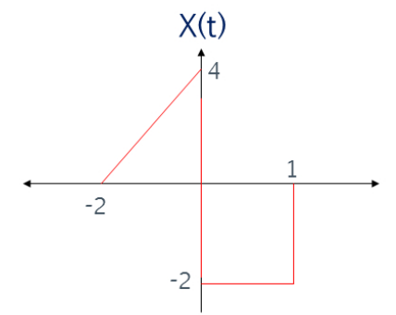
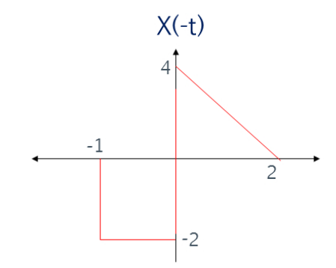
Reversal of Continuous-Time Signals Case-1: Time Reversal/Folding/Reflection
Folded on x-axis

Slide 10
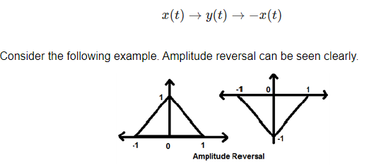
Reversal of Continuous-Time Signals Case-2: Amplitude Reversal (Folded on Y-axis)
It is the special form of Amplitude Scaling, in which amplitude multiply with (-1).
Whenever the amplitude of a signal is multiplied by -1, then it is known as amplitude reversal. In this case, the signal produces its mirror image about X-axis. Mathematically, this can be written as;

Slide 11
Even (Symmetric) and Odd (Anti-Symmetric OR Asymmetric) Signals
Signal remain same after folding operation is known as Even Signal OR
A signal is referred to as an even if it is identical to its time-reversed counterparts; x(t) = x(-t).
Signal Doesn’t remain same after folding operation is known as Odd Signal OR.
A signal is referred to as an odd if it is not identical to its time-reversed counterparts; x(t) = -x(-t)

Slide 12
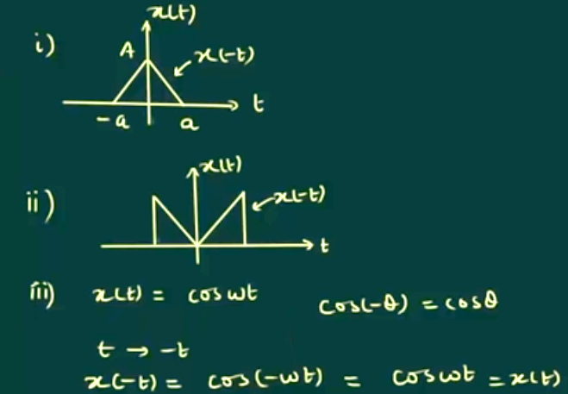
Even (Symmetric) and Odd (Anti-Symmetric OR Asymmetric) Signals

Slide 13
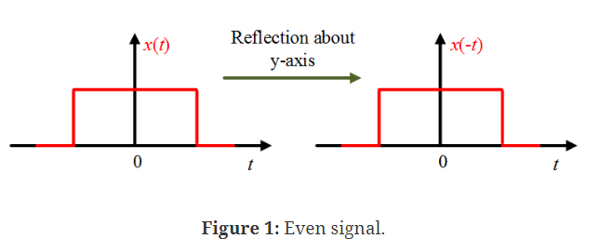
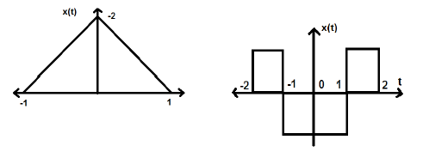
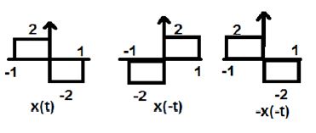
Even (Symmetric) and Odd (Anti-Symmetric OR Asymmetric) Signals

Slide 14
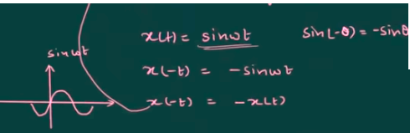
Even (Symmetric) and Odd (Anti-Symmetric OR Asymmetric) Signals

